Slide 1


Hiring Process Analytics
Prepared by : Shivam Singh
Email id: Shivamkumsingh@gmail.com

Slide 2

Contents
Project Description
Approach
Tech-Stack Used
Data Analytics Task & Insights
Result and Conclusion

Slide 3

Project Description
Analyzing previous hiring dataset of an MNC to observe trends and drawing insights out of it useful for hiring department.
The company database contains data of individuals who had enrolled for a certain position in a department of the company.
Using knowledge of statistics and different formulas in Excel to make important conclusions about the company.

Slide 4

Approach
Data Extraction: Downloaded and Imported the dataset into Excel.
Data Cleaning: Cleaned the data by removing missing or invalid entries and addressing any outliers.
Analysis: Used Pivot Tables and charts to visualize trends and uncover key insights and analyzed the findings and compiled them into a report.

Slide 5



Tech-Stack Used
Microsoft Excel: Used for data cleaning and visualizations. Excel provides powerful tools like charts, graphs, pivot tables, and various formatting options that make it easier to analyze and interpret data effectively.
Microsoft PowerPoint (PPT): Used for structuring and presenting insights.
Google Drive: Used for storing and sharing reports.

Slide 6
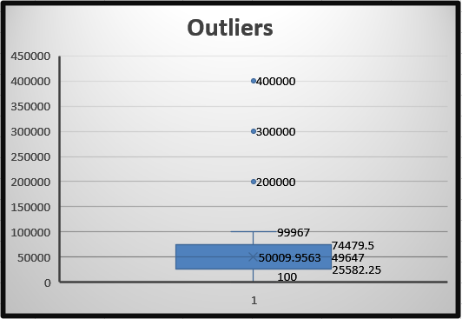
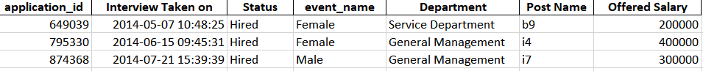
Data Analytics Task
There was blank cell in row number 80 in the “Offered Salary” column and was removed as it will not affect the data.
Column “Post Name”: “c-10” was replace by “c10” and “-” was replace by c9 as mode was approx. and according to “Offered Salary” column it comes under 85130 – 85837.
Column “event_name”: “-” was replace by “Don't want to say”.
application_id: Duplicates are removed.
Using IQR Method, 3 Outliers found (200000, 300000 and 400000) and were removed.
All the Insights are based on Sheet – “Without Outliers” only.
All the Charts are attached to respective tasks.
Click here for the Dataset used

Slide 7
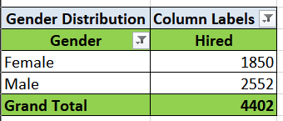
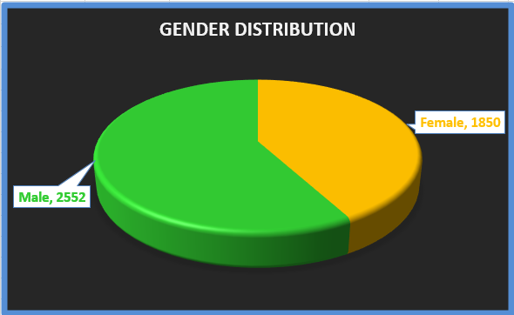

Insights
A. Hiring Analysis: Determine the gender distribution of hires. How many males and females have been hired by the company?
Total 4402 employee hired including 1850 Female and 2552 Male.

Slide 8
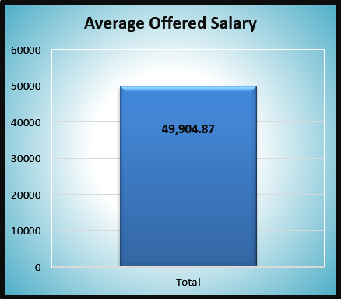

B. Salary Analysis: What is the average salary offered by this company?
Average Salary = Adding “Offered Salary” and dividing total number of employee (application_id)
Formula Used=AVERAGE(G2:G7138,A2:A7138)
The Average Salary offered by the company is 49904.87.

Slide 9
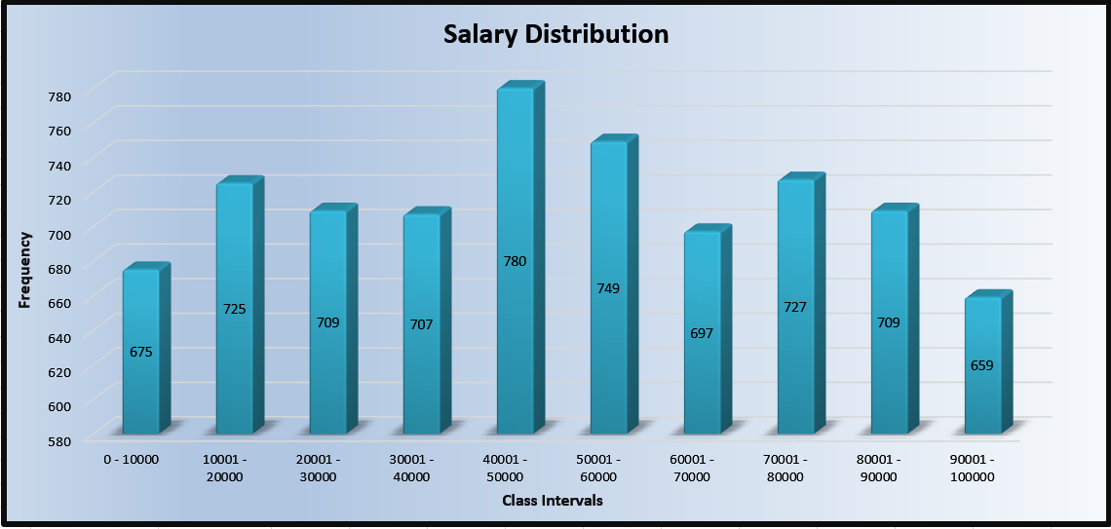
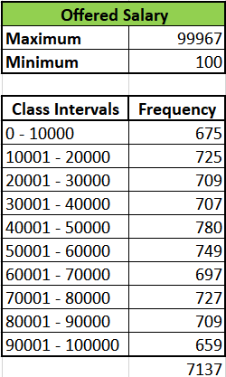
C. Salary Distribution: Create class intervals for the salaries in the company?
Formula: COUNTIFS(G2:G7138,">0",G2:G7138,"<10000") and for next frequency again from COUNIFS(G2:G7138,">10001",G2:G7138,"<20000") and so on.

Slide 10
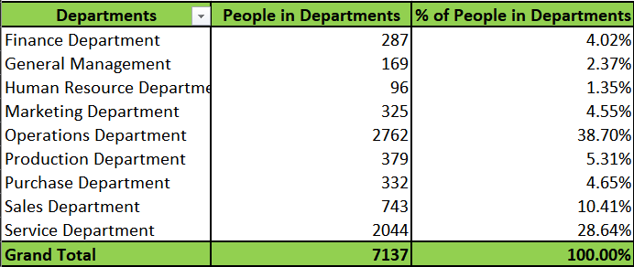
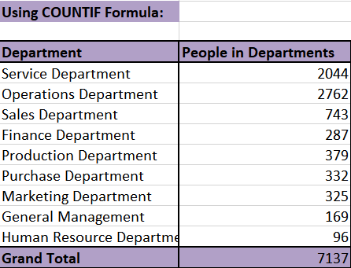
D. Departmental Analysis: Use a pie chart, bar graph, or any other suitable visualization to show the proportion of people working in different departments.
Solved by 2 methods:
1. Used Pivot Table and then Pie chart for visualization.
2. Using formula: =COUNTIF(E1:E7138,“Department") where Department is “Service Department” and so on till all 9 departments are not covered and then Pie chart for visualization.

Slide 11
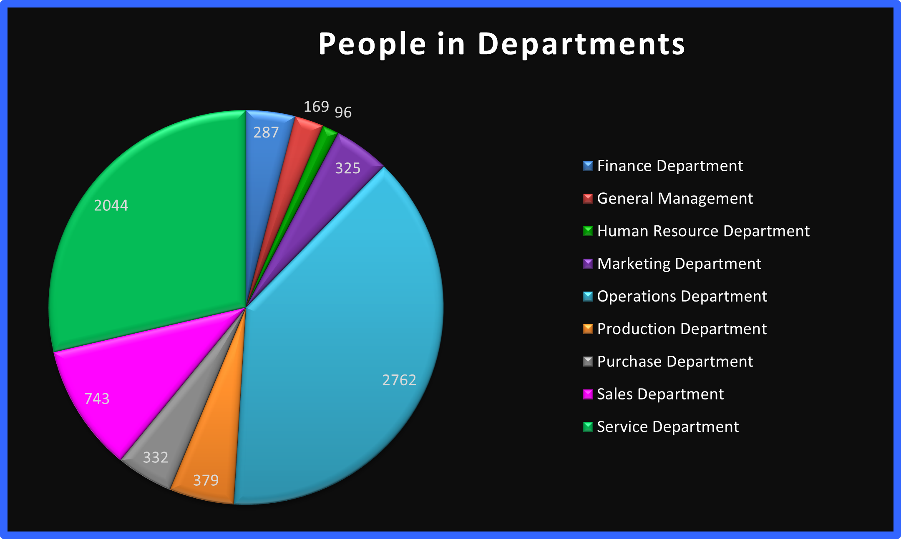
Operations Department and Service Department has highest hiring.
Whereas Human Resource Department and General Management has lowest hiring.

Slide 12
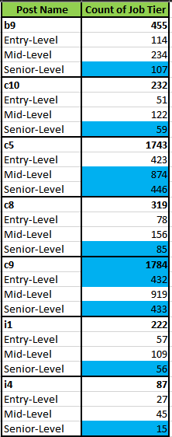
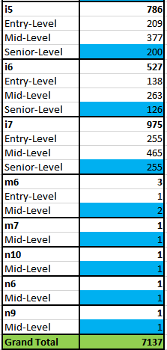
E. Position Tier Analysis: Use a chart or graph to represent the different position tiers within the company.
Used Pivot Table and then Clustered Column chart for visualization.
The Blue highlighted value indicates most frequent job Tier for each Post Name.

Slide 13
“Post Name” column was divided into “Job Tiers” column – Entry-Level, Mid-Level and Senior-Level on basis of “Offered Salary” column with:
Min - 100
Median - 49631 (=MEDIAN(G2:G7138)
Max - 99967
Use IF formula to get the Job Tiers: =IF(G2<=25582, "Entry-Level", IF(G2<=74479.5, "Mid-Level", "Senior-Level"))
Q1 = 25582 (=QUARTILE.INC(G2:G7138, 1)
Q3 = 74479.5 (=QUARTILE.INC(G2:G7138, 3)
25,583 – 74,479.5 Middle 50% (Q2–Q3 range)
According to that, below is the Job Tier Ranges:
Tier Salary Range Explanation
Entry-Level 100 – 25,582 Bottom 25% → salaries ≤ Q1
Mid-Level 25,583 – 74,479.5 Middle 50% → Q1 < salary ≤ Q3
Senior-Level 74,480 – 99,967 Top 25% → salaries > Q3
Used Pivot Table to create table for Post Name and Count of Job Tier and then use Conditional Formatting > New Rule > Last option under Rule Type > to highlight most frequent Job Tier for each Post Name:
=C2=MAXIFS(C:C, B:B, B2)
where
* Checks if C2 is the highest count for that specific Post Name.
* MAXIFS(C:C, B:B, B2) finds the highest "Count of Job Tier" for each Post Name.

Slide 14
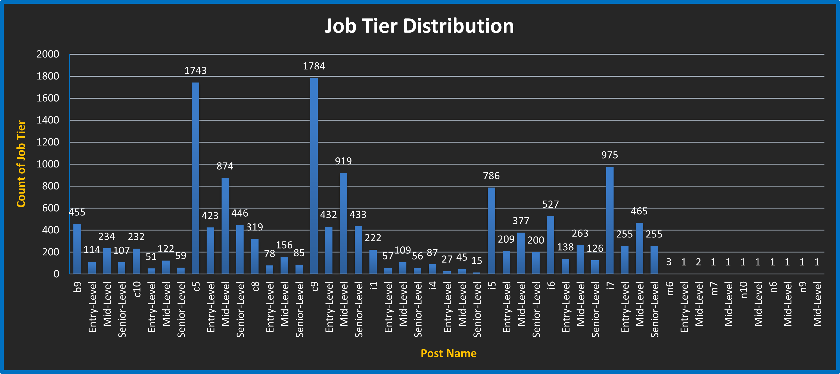
Post Name such as c9 and c5 have the highest number of hires, whereas positions like m6, m7, n10, n9, and n6 have the lowest hiring figures.

Slide 15

Results & Conclusion
Out of 4402 Employees, 58% (2552) of the workers being employed are males and 42% (1850) females, showing gender inequality.
The average salary of the company is ₹49904.8 ≈ ₹50000.
The General Management department has the highest average salary at ₹55,000, though it hires few.
Only three workers earn more than ₹1 lakh.
The C9 position is the most heavily recruited with the highest number of recruits.
After Analyzing we conclude that there is a gender skew in hiring moderately in favor of men (58%) over women (42%). Most salaries fall in the range of ₹25,000 to ₹75,000 with an average of ₹50,000. General Management is the highest paid on average (about ₹55,000) but has the fewest, meaning that it must have critical or specialized roles. C9 and C5 have the highest hiring, whereas M6, M7, N10, N9, and N6 have very minimal hiring. All this can be helpful to HR to narrow down hiring focus, salary planning, and diversity initiatives.

Slide 16


